Slide 1


CE-QUAL-W2 Model Outputs Overview
UNCLASSIFIED
Todd Steissberg
U.S. Army Engineer Research and Development Center, Environmental Laboratory
CE-QUAL-W2 Workshop, 2024
July 08 - 09, 2024
Environmental Systems
Modeling Team
UNCLASSIFIED

Slide 2
W2 Model Outputs
Model preprocessor outputs
pre.opt
pre.wrn
pre.err
Model outputs
w2.wrn
W2.err
W2ErrorDump.csv

Slide 3
W2 Model Output Files
1 SNP - Snapshot
2 PRF - Profile
3 SPR - Spreadsheet profile
4 W2L – W2Post
5 CPL - Contour
6 TECPLOT - Contour
7 FLUX - Kinetic fluxes
8 TSR - Time series
9 WLEVEL – Water level
10 FLOWBAL - Flow balance
11 NPBAL – N and P mass balance
WDO - Withdrawal outflow
RESTART

Slide 4
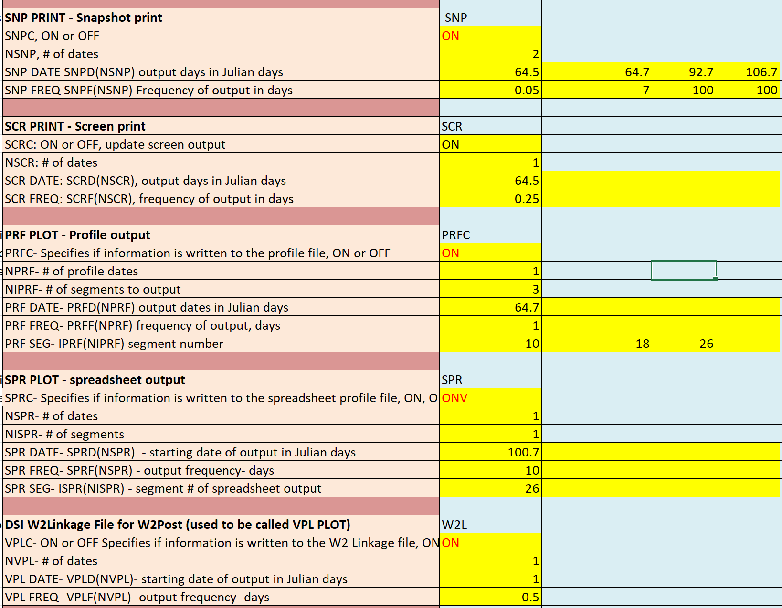
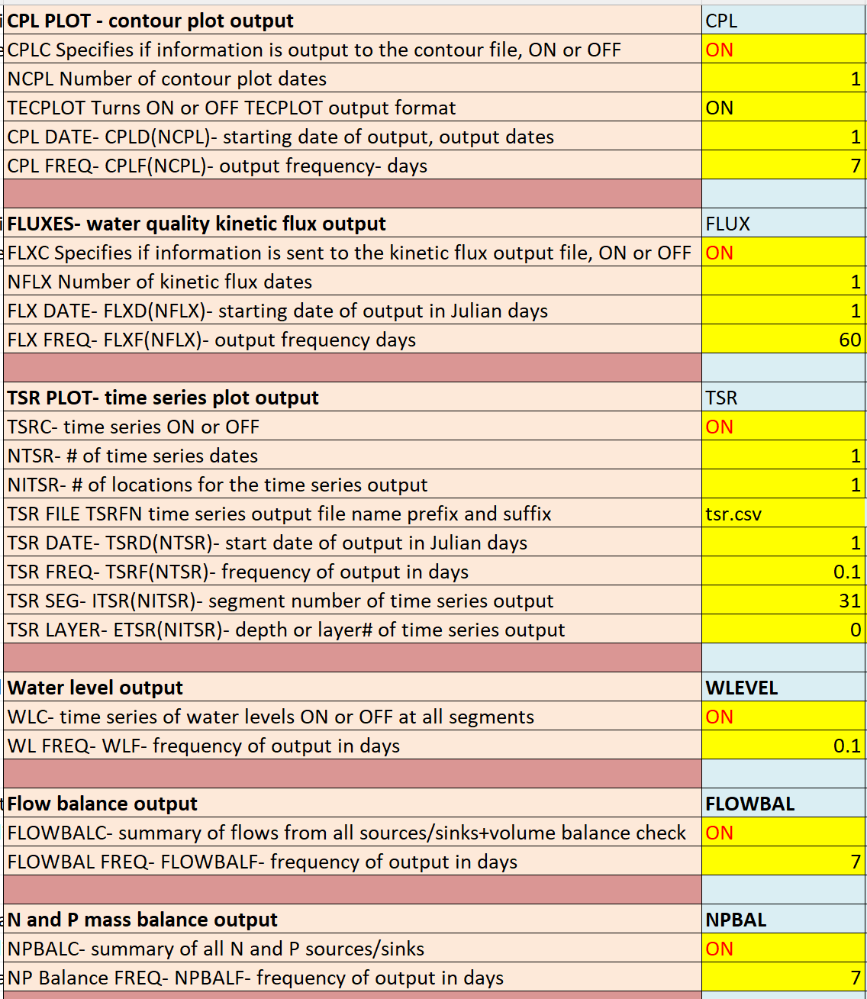
W2 Model Output Control

Slide 5
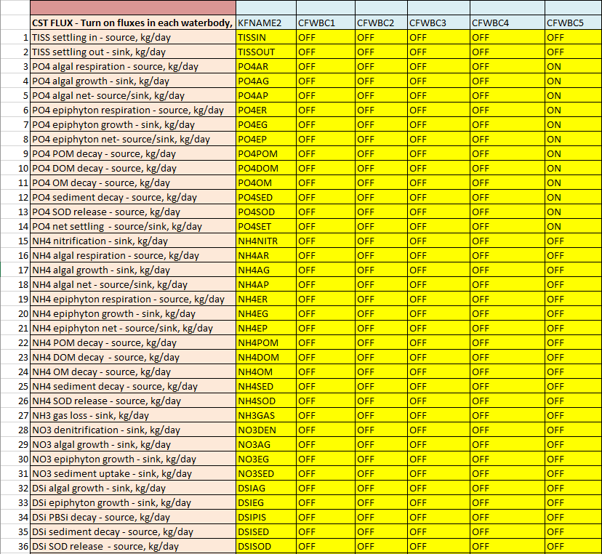
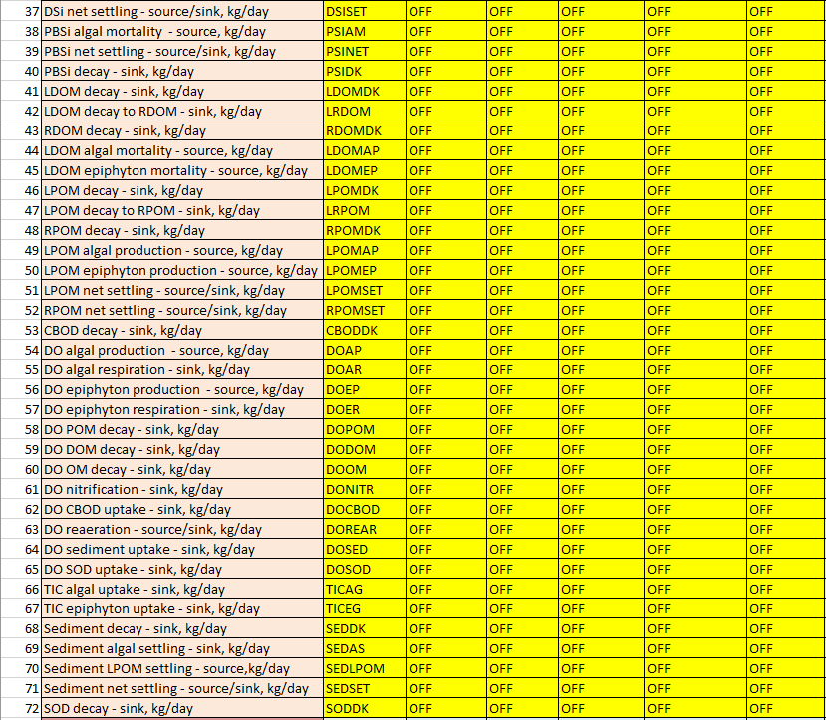
W2 Model Output Control

Slide 6
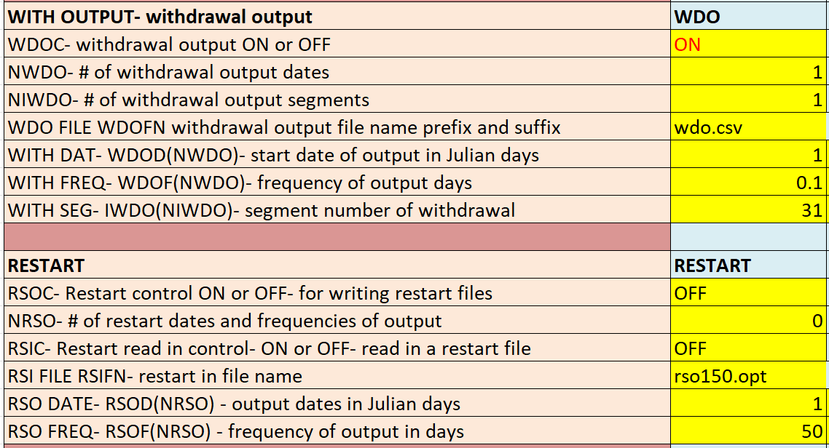
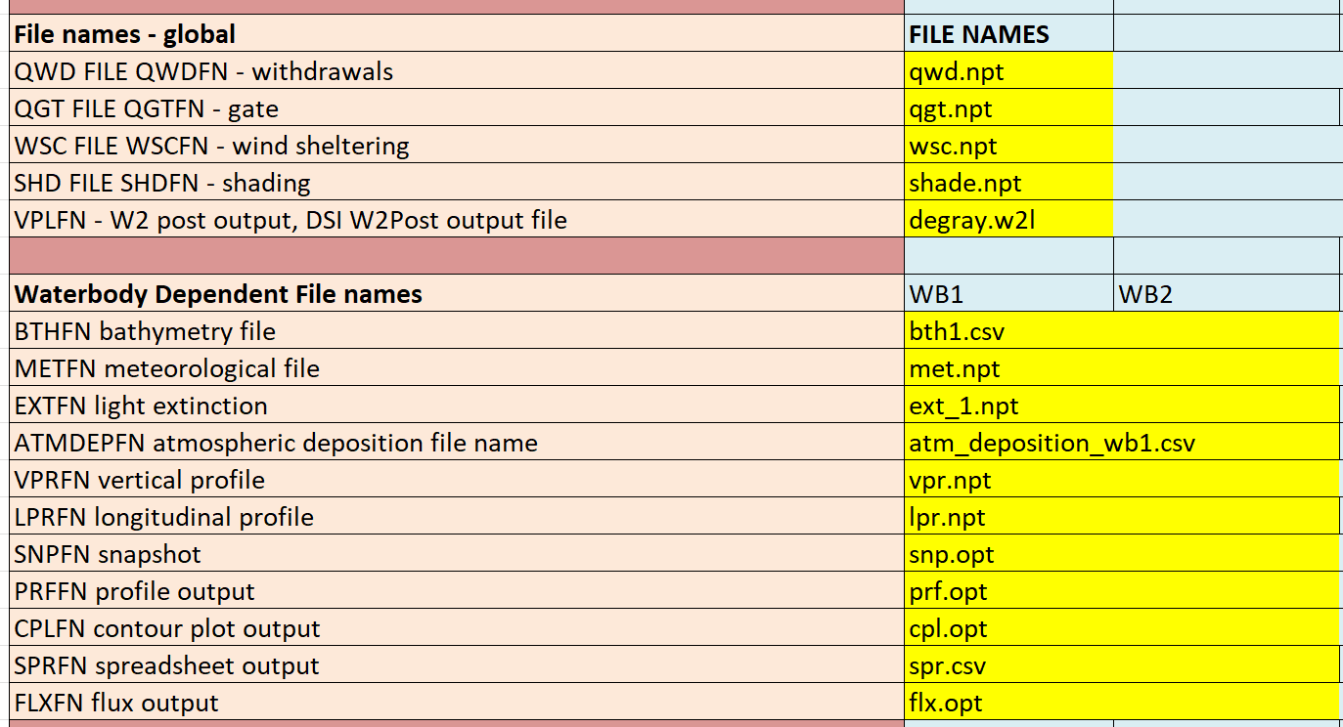
W2 Model Output Control

Slide 7
Review DeGray Reservoir Output Files
Run the DeGray W2 model
Review the following W2 model output files
pre.opt - Preprocessor
tsr_1_seg31.csv – Segment time series plot
spr.csv – Segment spreadsheet profile
flx.opt – Segment flux
kflux_wb1.csv – Waterbody flux
qwo_31.csv - Withdrawal outflow file for flow
two_31.csv - Withdrawal outflow file for temperature
cwo_31.csv - Withdrawal outflow file for constituent concentrations
dwo_31.csv - Withdrawal outflow file for derived constituent concentrations
wl.csv – Surface water level
flowbal.csv - Waterbody flow balance
massbal.csv - Waterbody N and P mass balance
degray.w2l - W2Post Postprocessor
snp.opt - Snapshot

Slide 8

Questions?

